Slide 1
RUNTIME CODE ADAPTATION

Slide 2
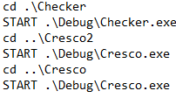
EXECUTE THE CRESCO MACHINES AND CHECKER
The CRESCO machines and the checker are started from a script because otherwise some commands to be used latter will fail (also more advisable for automatization).

Slide 3
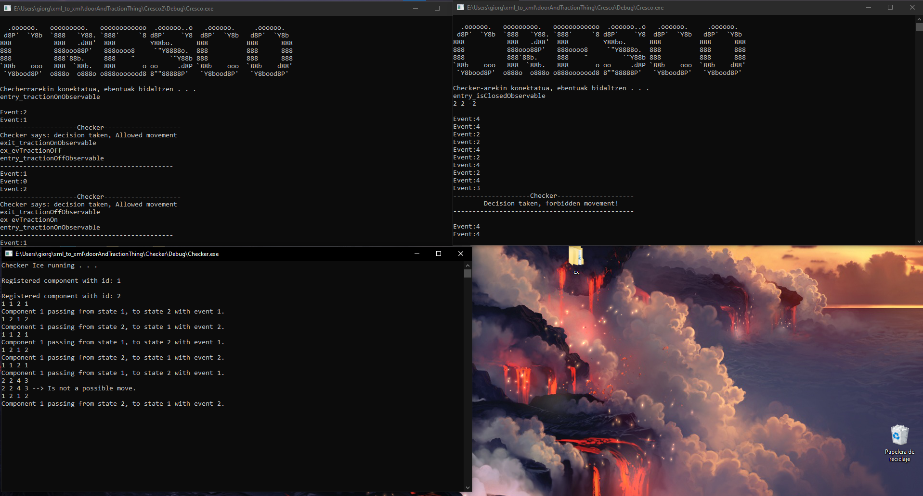
EXECUTE THE CRESCO MACHINES AND CHECKER
Cresco2 (doesn’t fail)
Cresco (can fail)
Fail
Checker

Slide 4

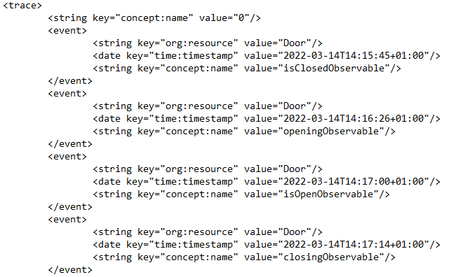
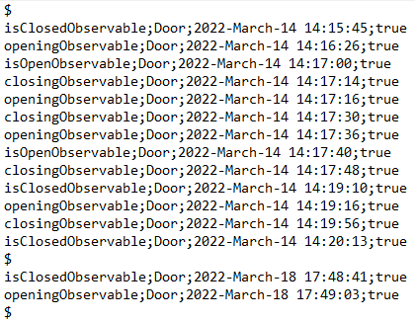
PERIODICAL XLOG GENERATION
Every 5 minutes, CRESCO will call the activateCresco.bat script to start the process to check if the machine is working correctly or not.
First, our handmade log will be converted to XLog format, using the program XES_Converter.

Slide 5

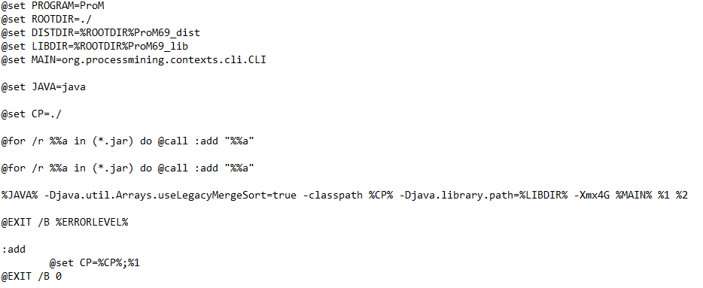

CONVERSION TO PETRINET
Once the XLog is generated, the XES_Converter program will move the generated file to the folder where ProM is installed, and it will then call the automaticFuzzyGen script.
The first thing that script will do is call another script, which is prepared to handle different actions related to ProM, with a text file containing Java commands.

Slide 6
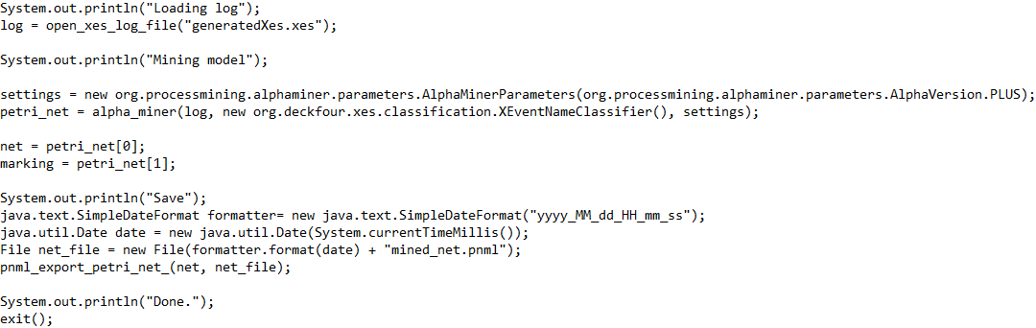
CONVERSION TO PETRINET
The code of fuzzy_creation5.txt is the following. This code will generate a new PetriNet using all the traces from the XLog file.

Slide 7

CHECKING IF VALID OR NOT
Once the PetriNet is created, the movePetri script will be called, which will move the PetriNet to another folder and use the rename_and_run script.

Slide 8
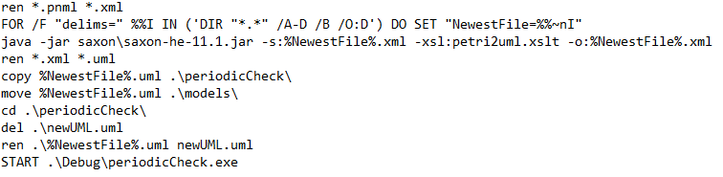
CHECKING IF VALID OR NOT
This script uses saxon to convert the PetriNet to a UML diagram. After that, the periodicCheck program is used, where it is determined whether the UML has changed in the last 5 minutes or not.

Slide 9
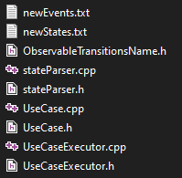
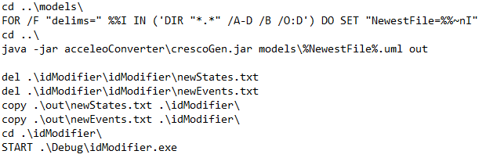
GENERATION OF CODE WHEN INVALID
If the UML has changed, the generateCode script will be invoked, using the jar of Acceleo to generate all the files to be used later.
Code from generateCode script.

Slide 10
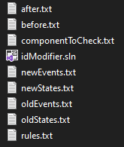
GENERATION OF CODE WHEN INVALID
Then the idModifier program will be called, in order to update the ID numbers that compose the checker’s rules. For that, the old values and the new values are compared.
Files used for the comparison

Slide 11
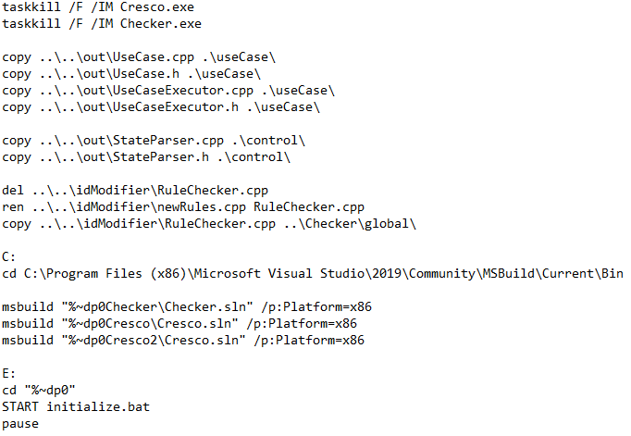
ERROR IN CRESCO MACHINE
If there is an error in a CRESCO machine (a not allowed action in an observable state), all the CRESCOs and the checker would be stopped, the previously generated code files would be used to replace the actual ones, the projects would be rebuilt, and the initialize script would be called to start all again.

